Slide 1
Consumer Lead Management Training

Slide 2
Agenda
What’s changing, and why?
Program Overview and Goals
Lead Management Tool Training
Where do Leads come from?
Lead Submission Form
Getting Started as an Account Executive
Salesforce Accounts
The Accounts Tab
High Level Flow
Dealer Lead Assignment
Reassignment of a Lead
Using Lists to Search For Leads Needing Actioned
Visibility of Leads
Confirming/Changing AE Assignment
Login Experience as User
Disable a Partner Account
Disable a Partner Use
Dealer’s Login
How to Login to Channel One
Finding and Managing my Leads
Salesforce Home Page
Dealer Lead Assignment
Reviewing Lead Information
Lead and Dealer Compatibility
Lead Stages
Lead not Accepted
Lead Status
Reasons for Rejection
Leads Dashboard
Leads Dashboard Detail
Q&A

Slide 3
What is changing, and why?

Slide 4
Program Overview
Goal: Delivering an improved lead management software platform for our channel partners.
The Consumer Team is actively working on a new Lead to Order Management Solution. This initiative will provide channel partners a lead management and ordering tool for the Power Generation Consumer business, which will completely transform how we manage the ordering process for our channel partners and provide them with an improved experience including being able to input and track their orders.
This initial launch will upgrade the lead management process, future phases will encompass the ordering process.
Enable Lead Management to Salesforce
Discontinue existing platform
Increase productivity through creating the ability to track lead quality and conversion success
Automate business process and Enable channel efficiency
Increase sales
Enhanced data analytics and business intelligence for more informed decisions
Scalable to other market segments
Internal Use Only

Slide 5
Lead Management Tool Training
Where do Leads come from?
Lead Submission Form
Account Executive Roles & Responsibilities
Dealers Roles & Responsibilities
Notes:
Onboarding and atr-ned tomorrow

Slide 6
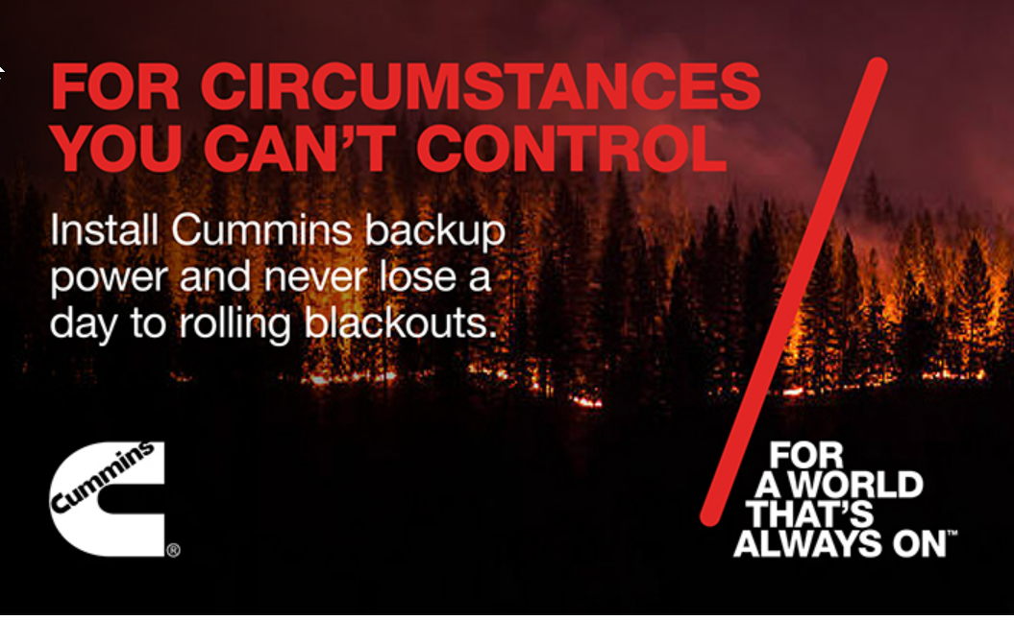
Where do leads come from?
Customers can submit a 'request for contact' by completing an online lead submission form found on the Cummins website and campaigns. There are currently 4 different banners leading the customer to the online form.
Additional means for capturing lead data will be introduced in the future and all leads will continue to flow into Salesforce for Dealers to action.
Click on the images below to jump to relevant locations.

Slide 7
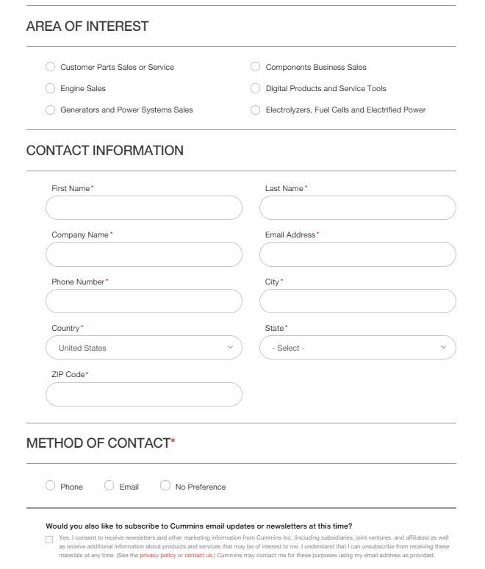
Lead Submission Form
The potential customer fills out the online form indicating their area of interest (in this case “Generators and Power Systems Sales”)
Contact details are mandatory for the potential customer to fill out.
The information provided in the form gets transferred to the Salesforce 'Lead Management' section.
There is also an option at the end giving the opportunity to subscribe to the Cummins newsletter to stay informed about updates.
John
Smith
John’s Company
John.smith@email.com
123 456 7890
Anytown
Any State
12345
Notes:
Valid for US and Canada

Slide 8
Account Executives
AE only
Account Executives focus on extending the dealer network and onboarding new channel partners to sell, install and service Cummins gensets for home and small business applications.

Slide 9
Salesforce Accounts
AE only
To get started:
Go to your Salesforce account and log in entering your credentials.
In your home page, click on ‘Accounts’ tab.

Slide 10
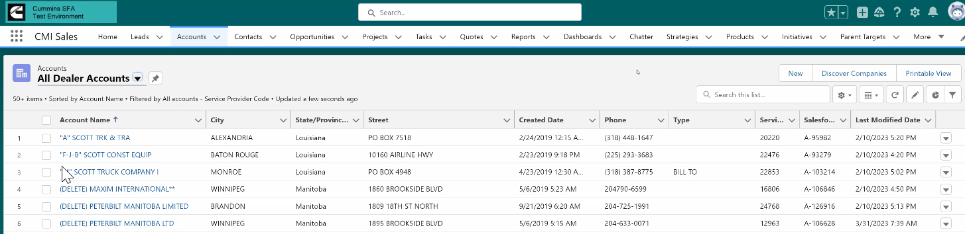
The “Accounts” Tab
AE only
When the ‘Accounts’ tab is opened, you can either create a new account or work with an existing account
To create a new account: go to the next slide
To work with an existing account (Dealer):
Start by selecting ‘all dealer accounts’ from the drop-down list [1].
Next, use the search function [2], entering specific key words to search for the dealer you are looking for, for example, if you are looking for dealers in Michigan, type “Michigan”.
From the list [3], select the one you want to continue with by clicking on its name.
1
2
3

Slide 11
High Level Flow – Steps to Create New Partner Account & User(s) more details on next slides
AE only
Once a new partner account is identified, instruct the dealer to create a Channel One user account by logging into channelone.cummins.com and clicking create account.
The dealer sends their Channel One username to their AE.
The AE reviews Salesforce to see if the Dealer already has an account set up.
If they DO NOT, AE contacts Zach Hanson, Dealer Support Specialist, to set it up.
AE Enables the account to be a Partner Account
AE sets one email address for Lead Assignment and sets lead threshold
AE creates contact records for the people who will login to the portal to manage leads. *at least one contact should be the same as the lead assignment email address
AE create an ATR in Salesforce and provides the Dealer Account Name, Email Address, Region and Channel One user name.
IT locates the contact and enables them as a portal user. (The enables single sign on)
An email notification will go to the dealer letting them know they can now login to the portal

Slide 12
AE only
Once a new partner account is identified, instruct the dealer to create a Channel One user account by logging into channelone.cummins.com and clicking create account.
The Channel 1 portal is the single-entry point for Cummins dealers and allows them access to key systems and processes, including Salesforce.
For those not having access to Channel 1 or Salesforce, it is considered best practice to create your account through Channel 1.
Dealers who do not have access to Channel 1, should click on ‘create account’ and get account assigned.
Additional instructions on access requests are found by clicking the ‘Click Here’ button.

Slide 13
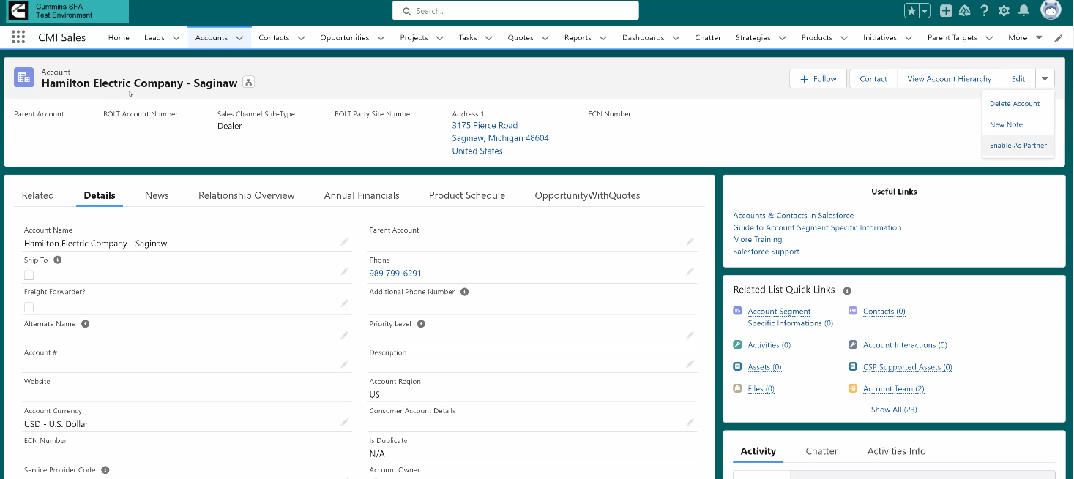
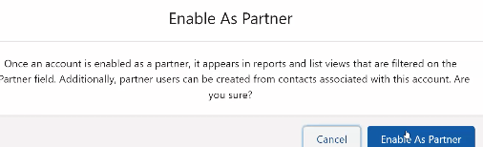
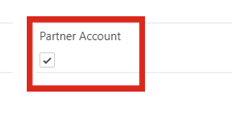
AE only
AE Enables the account to be a Partner Account
After having created a new dealer account or selecting an existing one you will see that dealers account page displayed
To enable portal use, first you need to enable the Dealer as a partner
Click the Edit drop down at the top right of the page
Select ‘Enable as Partner’
Then, in the pop up, continue by clicking ‘Enable as partner’
You can confirm a dealer is set up as a portal partner account by going to the details tab, scrolling down about ½ way and seeing if the check box is checked.

Slide 14
AE only
AE sets one email address for Lead Assignment and sets lead threshold
AE creates contact records for the people who will login to the portal to manage leads. *at least one contact should be the same as the lead assignment email address
These two steps must be done together to enable the dealer to view and manage the leads assigned to them.
On Account in the Details tab – about ½ way down you will see the options for Lead Assignment – click on the pencil to update.
Check the box for “Lead Assignment Enabled” and set the Lead Threshold. Lead threshold is the maximum number of active leads (not in unqualified or lost status) that can be assigned to that dealer at any given time. This should not exceed 50.
Input the email address(es) the leads should go to.
IMPORTANT: Inputting the email address in here without creating the user contact information will cause the dealer to get leads, but they WILL NOT be able to login to do anything with them.

Slide 15
AE only
AE creates contact records for the people who will login to the portal to manage leads. *at least one contact should be the same as the lead assignment email address
At a minimum, the email address you added for lead assignment needs to be set up as a Partner User in order to gain access to the portal and update the leads.
Enabling Partner USERS drives a license cost. Currently there is a limit of one user per partner account. If you have a special circumstance and require more users, please reach out to your zone leader. This will be reevaluated as we move into Phase 2.
To do this, on the Account, click the “Contact” button in the top right. [1]
Input all the details of the contact in the ‘Contact information’ pop up [2], Note that information including their phone number, email address and contact name is critical and mandatory.
1
2

Slide 16
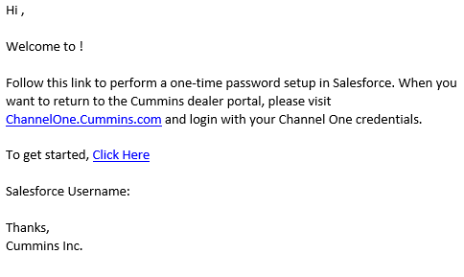
AE only
AE create an ATR in Salesforce and provides the Dealer Account Name, Email Address, Region and Channel One user name.
IT locates the contact and enables them as a portal user. (The enables single sign on)
An email notification will go to the dealer letting them know they can now login to the portal
To enable that specific user access to the portal, the AE needs to create an ATR requesting IT to enable them as a PARTNER USER.
In Salesforce, Click on Requests then “New Request”
Idea, Category and Type are mandatory fields
Idea = Dealer Account Name, Email Address, Region and Channel One User Name
Category = Dealer Onboarding
Type = User Management
An email will go to the dealer letting them know their account has been created.
Please note: You can add contacts in Salesforce WITHOUT making them users. Only contacts you want to be users need an ATR.

Slide 17
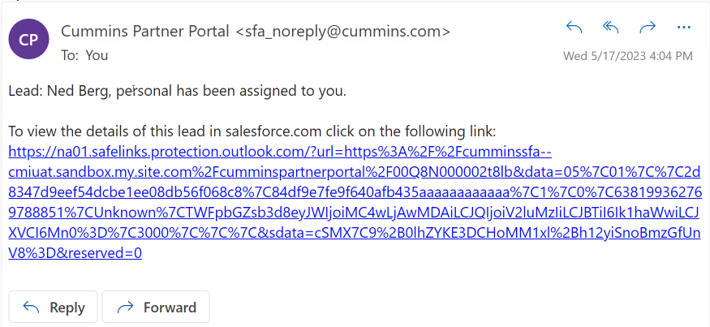
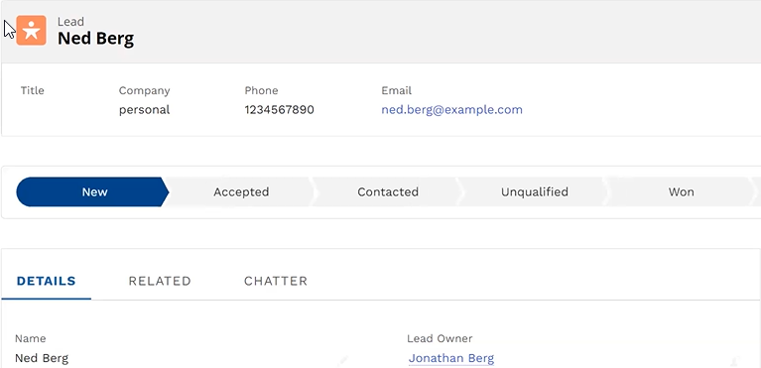
Dealer Lead Assignment
AE only
As leads come into to the system, they will be assigned to the dealership based on proximity and lead threshold rules. The lead ZIP codes will be matched with the dealership zip code. The lead will be directed to the appropriate dealer automatically.
As the lead is assigned, the Dealer will automatically receive an email (using the email address stored in the lead assignment with a link to the lead.
When the Dealer clicks on the link they will be taken to the Lead profile on Salesforce and will then have up to 2 business days to accept or reject the lead.
Rejected leads will be returned to their AE for manual reassignment to another suitable dealer.
Unactioned leads will be reassigned to another dealer up to 3 times before being returned to the AE.
Lead assignment email
Lead profile

Slide 18
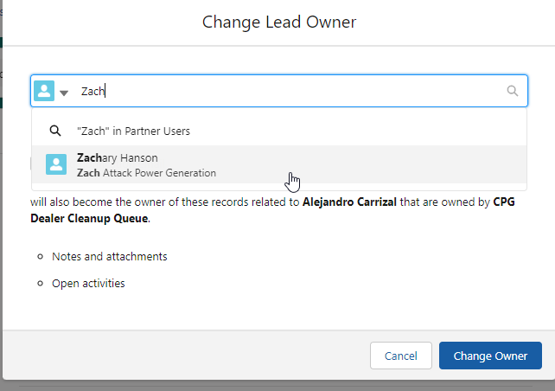
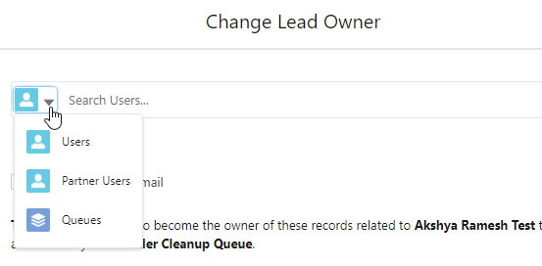
Reassignment of a Lead
To manually reassign a lead, locate the lead and click on the person icon at the top under “Lead Owner” [1]
Click the Drop Down [2] to begin your search
Users = AE’s
Partner Users = Dealers
You will need to search for the partner users NAME, however, the Dealer Name will also populate with the User Name to help you identify the right User [3]
Queues will not be used
1
2
3

Slide 19
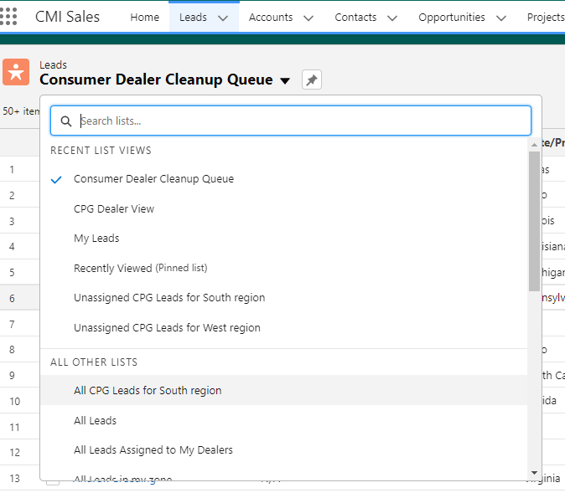
Using Lists to Search for Leads Needing Actioned
AE only
Under Leads there are multiple list views to help you narrow your search
My Leads
Unassigned leads by Zone
All leads for a specific zone
All leads assigned to your dealers

Slide 20
Visibility of Leads
AE only
Dealers can only see their leads
AE’s can see all leads assigned to their dealers and those leads assigned to them directly.
Zone Leaders can see all leads assigned to their AE’s and to all the dealers in their zone.
An AE can reassign a lead to any other AE in any zone.

Slide 21
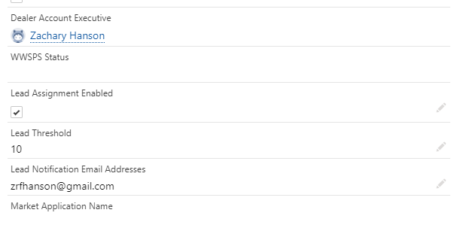
Confirming / Changing AE Assignment
Navigate to the Account - the Dealer Account Executive field is located about ½ way down above the Lead Assignment details.
If this needs to be changed navigate to the “Related” tab on the account, then click on Account Team

Slide 22
Confirming / Changing AE Assignment
Click on “Add Team Members” in the top right and the box shown below will display.
Use the pencil icons to edit the fields.
User = AE
Team Role = Dealer Account Executive (last option in the list)
Account Access should be changed to Read / Write
Click Save
The proper Dealer Account Executive will now be listed on the Account > Details screen

Slide 23
Log in to experience as User
AE only
To assist with troubleshooting, it is possible to log in to experience the portal as your dealer would see it.
Navigate to the User Account contact under the main account
Click “Log in to Experience as User”
Please note, this is a live version of the dealer’s portal.

Slide 24
Disabling a Partner ACCOUNT
AE only
To disable a complete ACCOUNT, navigate to the “Details” on the account and just like you enabled it, click “Disable Partner Account”
IMPORTANT: Disabling a partner account automatically disables ALL partner USERS.

Slide 25
Disabling a Partner USER
AE only
To disable just one USER on an account, navigate to the ACCOUNT and then click CONTACTS
Click on the Contact you want to disable
Navigate to the drop down and click “Disable Partner User”
FYI
You can change the lead assignment email at any time just make sure the email you change it to is set up as a USER.
You can also turn on or off automatic lead assignment at any time

Slide 26
Dealer’s Login
Dealer

Slide 27
As a Dealer, how do I log in to Channel 1?
Dealer
The Channel 1 portal is the single-entry point for Cummins dealers and allows them access to key systems and processes, including Salesforce.
For those not having access to Channel 1 or Salesforce, it is considered best practice to create your account through Channel 1.
Dealers who already have access to Channel 1, should enter their credentials after having clicked on ‘login’. [1]
Dealers who do not have access to Channel 1, should click on ‘create account’ and get account assigned. [2]
Additional instructions on access requests are found by clicking the ‘Click Here’ button. [3]
1
2
3

Slide 28
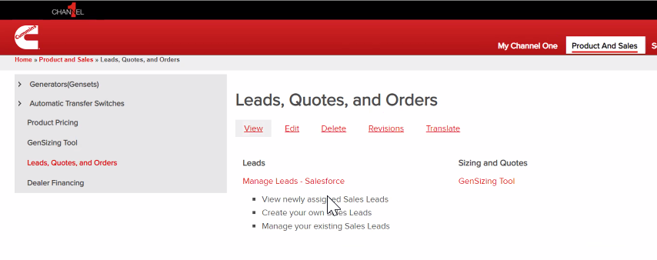
Finding & Managing my Leads
Dealer
Dealers are responsible for reviewing and managing the leads assigned to them. In order to do this the following steps should be followed:
Log into the Channel 1 Dealer Portal as per the previous instructions
On the home page click on ‘Products and Sales’ tab [1]
Then click ‘Leads, quotes and orders’ [2]
Once on the ‘Leads, Quotes, and Orders’ page click ‘Managing Leads’[3] which will direct the user to the Salesforce platform.
Please note, that if you do not have access to Salesforce yet, clicking on “Manage Leads” will bring you to a login credentials screen. If this happens, contact your AE with your Channel 1 username to being the setup process for gaining access to Salesforce.
1
2
3

Slide 29
Salesforce Home Page
Dealer
Once your Salesforce account is established you do not need to access it through Channel 1, you can go direct to Salesforce, although you still can access it through Channel 1 if you choose.
The Salesforce application is available on a phone, tablet and laptop however it requires internet connection.
The navigation bar shown in blue encompasses multiple tabs including data about leads:
Home: a Dealer can see a snapshot of new leads, accepted leads, contacted leads and some metrics.
Lead: Prospective Customers are listed here.
Reports: A set of Records that meets certain criteria, displayed in an organized format.
Dashboards: A visual representation of the data within a source report.
Navigation Bar
Notes:
Control panel??

Slide 30
Dealer Lead Assignment
Dealer
As leads come into to the system, they will be automatically assigned to the dealership based on proximity. The leads ZIP codes will be matched with the dealership’s zip codes.
Once assigned, the dealer will automatically receive an email with a link to the lead.
Clicking the link, the individual will be taken to the Lead profile on Salesforce and will then have up to 2 business days to review and accept or reject the lead.
Not actioning the lead within 2 business days will automatically cause the lead to be reassigned.
Lead assignment email
Lead profile

Slide 31
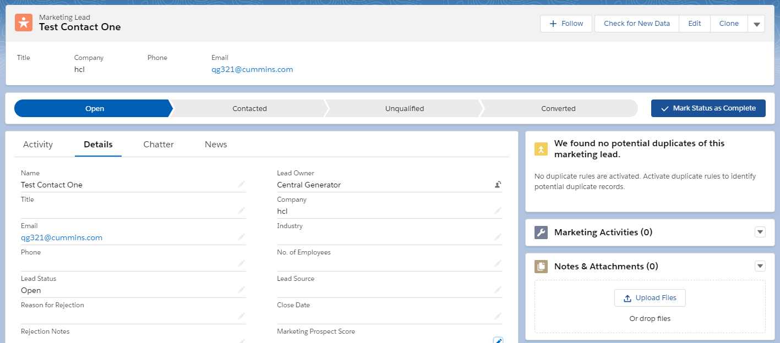
Reviewing Lead Information
Dealer
Having been assigned a lead, the dealer must now review the lead information.
The main view includes:
Key Fields [1] – Key Customer Contact Information
Lead Stages [2] – tracks progress of the lead through the process
Activity and Details tabs [3] – includes full customer details and dealer activities on that lead
1
2
3

Slide 32
Lead and Dealer Compatibility
Dealer
From the profile of a specific lead, the dealer can see the details like the goal of the customer as well as their address to evaluate if they are viable prospects. The Dealer may consider the proximity of the customer and their specific requirements before accepting or rejecting the lead.
If the dealer wishes to continue with the initial lead qualification, then they click on ‘accepted’ and update the status by ‘mark status as complete’. The dealer does not contact them on this step, but this is a commitment signifying that they will be contacting the customer as the next step.
Please remember to hit ‘save’ at the bottom of the page after each update.

Slide 33
Lead Stages
Dealer
To move stages on the timeline shown, click on the specific status and then update it by clicking on ‘mark status as complete’ on the very right. Please remember to hit ‘save’ at the bottom of the page after each update.
If the dealer wishes to continue with the initial lead qualification, then they click on ‘accepted’ and update the status by ‘mark status as complete’. The dealer does not contact them on this step, but this is a commitment signifying that they will be contacting the customer as the next step.
Converted is not used in the current phase but will be updated in the future capabilities to reflect the ordering status.
The dealer then contacts the lead and lets them know that their interest has been received. Leaving messages, sending emails and giving calls are considered as ‘contacted’. The dealer can write down their notes taken on the call in the ‘lead notes.’

Slide 34
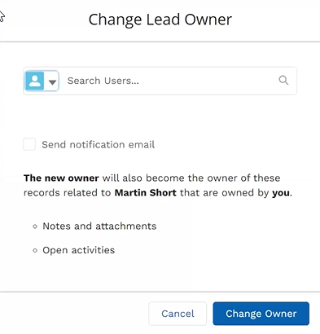
Lead not Accepted
Dealer
If the dealer decides that they will not be able to work with the lead, the dealer will need to change the owner of the lead back to the Account Executive, so it can be assigned to another dealer.
To reassign a lead, please go to the details tab of the lead.
Click on the icon next to the name of the lead owner (AE) [1].
Search for the name of your AE, and when found click on ‘Change Owner”.
1
Your Account Executive
Your Account Executive
Your Account Executive

Slide 35
Lead Status
Dealer
Unqualified
Won
Lost
The lead is unqualified if they decide not to move ahead with the purchase from any supplier. It cannot be classified as lost or won, as there is no opportunity to sell.
If won, congratulations! Please mark the opportunity as won.
If the lead opts for another supplier, the opportunity is lost.

Slide 36
Reasons for Rejection
Dealer
Dealer will need to provide reasons of rejection when Unqualified or Lost. There are several options in the “Reasons for Rejection” dropdown, pick the one that applies:
Just Browsing, not ready to buy
Lost to Competitor – price too high
Lost to Competitor – leadtime
Lost to Competitor – not the right fit product
No Customer Response
Financing Option Not Available
Service Inquiry
RV Inquiry
Career Inquiry
SPAM
Why is this important?
Marketing uses this information to improve campaigns and to measure the quality of our leads.
***Remember to hit on the ‘save’ button after your selection at the bottom of the page to proceed***

Slide 37
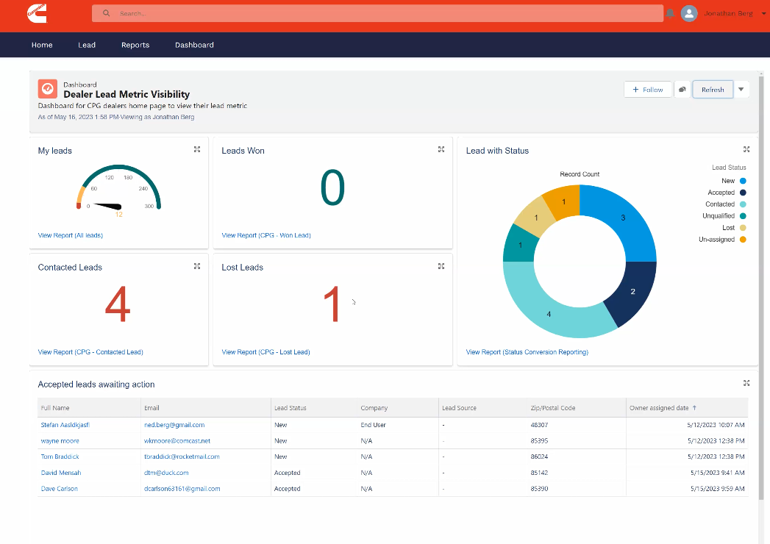
Leads Dashboard
Dealer
The dashboard feature can be accessed from the navigation bar by clicking on ‘dashboard’ [1]
The dashboard displays real time data and is refreshed using on the ‘refresh’ button [2]
It gives the dealer an, easy to digest, view of status with a number of statistics and graphs.
1
2
Notes:
NOT THE REFRESH BUTTON ON WEB

Slide 38
Leads Dashboard Detail
The left side of the dashboard displays four key statistics for the Dealer
My Leads [1] displays the total number of leads assigned to the dealer
Contacted Leads [2] displays the number of leads the dealer has update the lead stage to ‘Contacted’
Leads Won [3] displays the number of leads the dealer has updated the lead stage to ‘Won’
Lost Leads [4] displays the number of leads the dealer has updated the lead stage to ‘Lost’
1
3
2
4
The right side of the dashboard displays a summary of the dealers total lead assignment
Leads are broken out by the six stages of the lead tracking process
Gives the dealer an overview of the leads and can be used to focus resource on areas of opportunity e.g. contacted but not yet qualified

Slide 39
Q+A

